Slide 1
Phases of the Moon

Slide 2
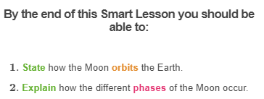
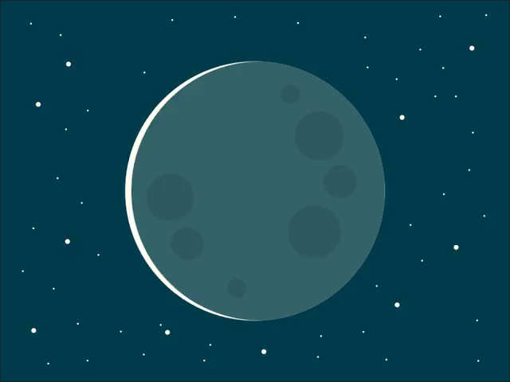

Slide 3
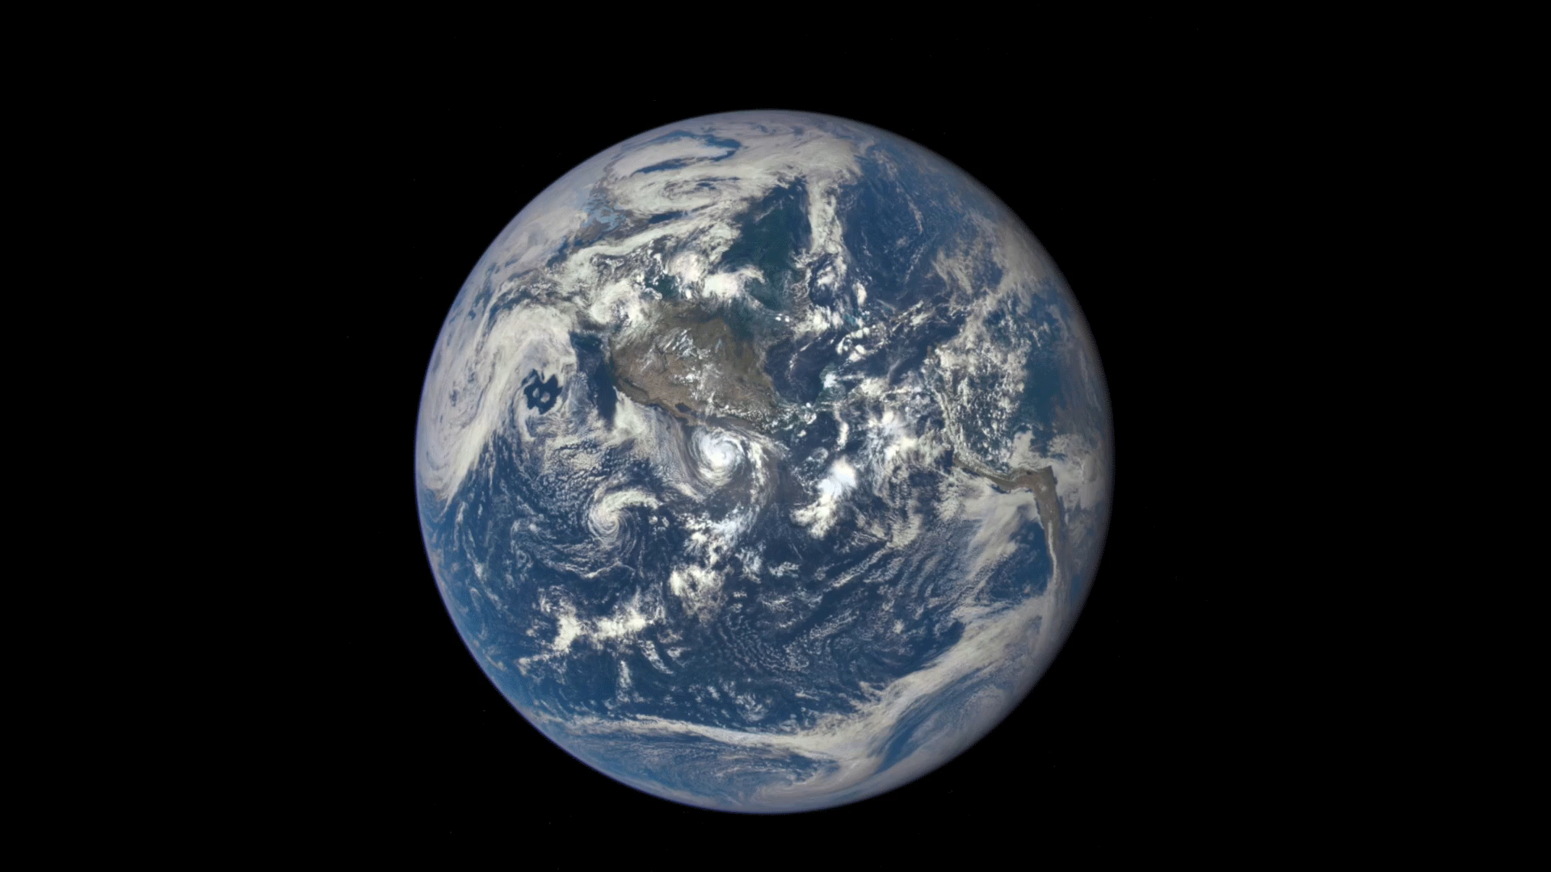
The Earth is the third planet from the Sun.
The Moon is a natural satellite of the Earth, which means it orbits around the Earth.

Slide 4
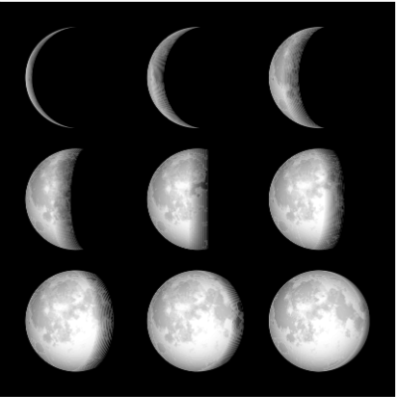
Have you ever wondered why the Moon appears to change shape in the night sky?
In reality, the Moon doesn't actually change shape. The changing shape of the bright part of the Moon that we see is called its phase.
The Moon is illuminated because it reflects the light from the sun. The part of the Moon facing the sun is lit up. The part facing away from the Sun is in darkness.

Slide 5
As the Moon revolves around the Earth, the side of the Moon facing the Sun is always illuminated.
However, the amount of illuminated moon we can see from Earth changes depending on the position of the Moon in relation to the Earth and Sun!

Slide 6
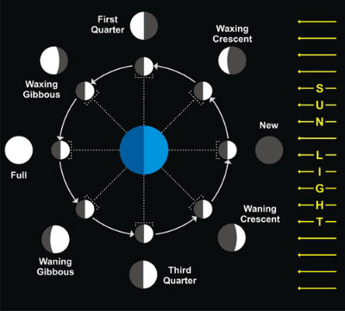
In the diagram below, sunlight is shining from the right.
In the centre is the Earth, and around that are eight different positions of the Moon in relation to the Earth and Sun.
Notice that these always have the side of the Moon facing the Sun illuminated. Around the outside are pictures of what the Moon in each of these positions looks like from Earth: these are the different phases.

Slide 7
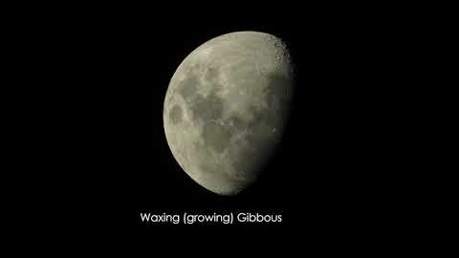

Slide 8
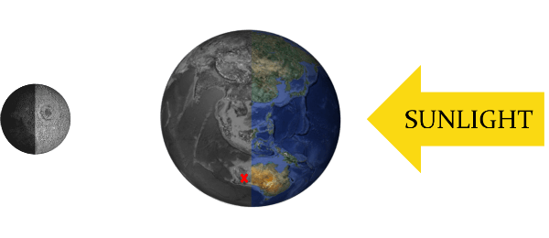
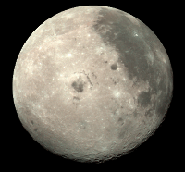
A full moon is seen when the Earth is between the Moon and the Sun:
From the red X, we see a full moon:

Slide 9
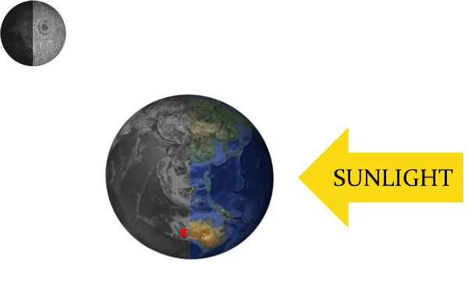
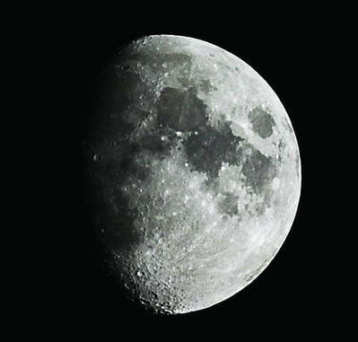
A gibbous moon is when we can see more than half of the Moon illuminated:
From the red X, we see a gibbous moon:

Slide 10
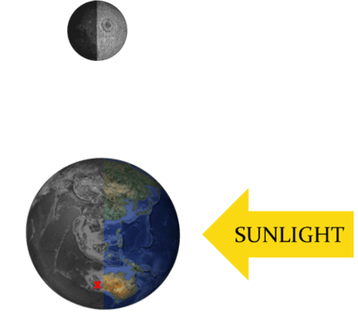
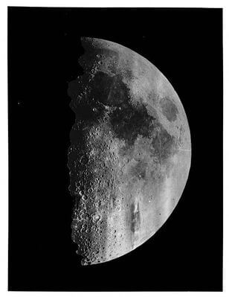
A quarter moon is when we can see half of the visible Moon illuminated (i.e. a quarter of the whole Moon):
From the red X, we see a quarter moon:

Slide 11
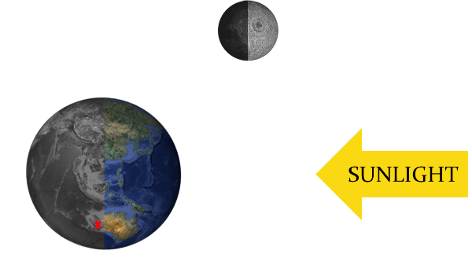
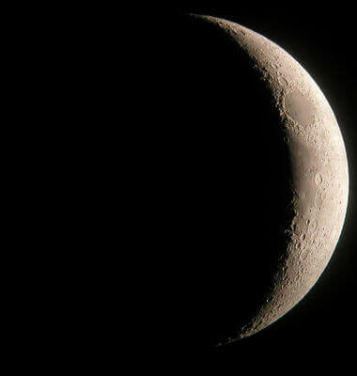
A crescent moon is when we can see less than half of the Moon illuminated:
From the red X, we see a crescent moon:

Slide 12
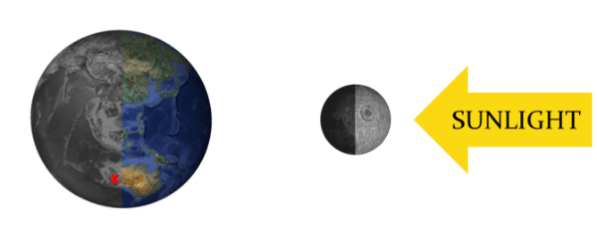
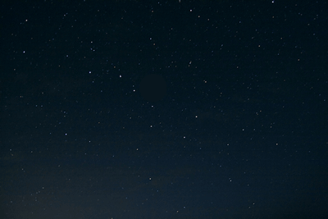
A new moon is when we can see none of the Moon illuminated. The Moon is between the Earth and the Sun:
From the red X, we see a new moon (i.e. no Moon):

Slide 13
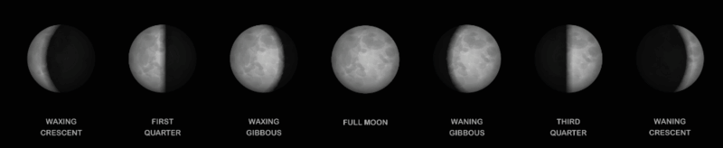
Waxing and Waning
As the Moon moves from new to full, we see more and more of the Moon. This is called waxing.
As the Moon moves from full to new, we start to see less and less of the Moon. This is called waning.
You could remember these by waXing = eXpanding.

Slide 14
Summary of the Moon Phases
Full moons occur when we can see all of the illuminated Moon.
New moons occur when we cannot seen any of the illuminated Moon.
Quarter moons occur when we can only see half of the illuminated Moon.
Crescent moons occur when we can see less than half of the illuminated Moon.
Gibbous moons occur when we can see more than half of the illuminated Moon.

